Slide 1
DevOps Engineer Technical Assessment
Objective
The objective was to deploy simple web application securely "Hello World" on AWS using VPC, private EC2 instances with Nginx as service, and Application Load Balancer(ALB). Everything done with best practices with no direct internet access to your servers Using AWS console.

Slide 2
Architecture Diagram
Traffic flow
Internet → ALB → EC2 (Private)
VPC (10.0.0.0/16)
2 Public Subnets
Public Subnet 1 (AZ-a) – 10.0.1.0/24
Public Subnet 2 (AZ-b) – 10.0.2.0/24
Application Load Balancer
2 Private Subnets
Private Subnet 1 (AZ-a) – 10.0.3.0/24 → EC2 + Nginx
Private Subnet 2 (AZ-b) – 10.0.4.0/24 → EC2 + Nginx

Slide 3
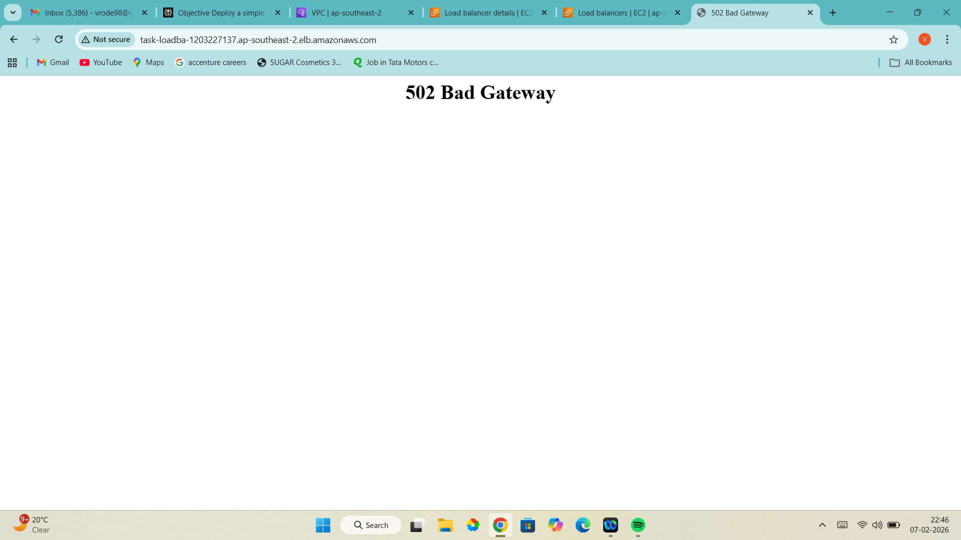
Working Application
As working of loadbancer URL, it showing 502 Bad Gateway means alb is not getting nginx. It will resolve soon

Slide 4
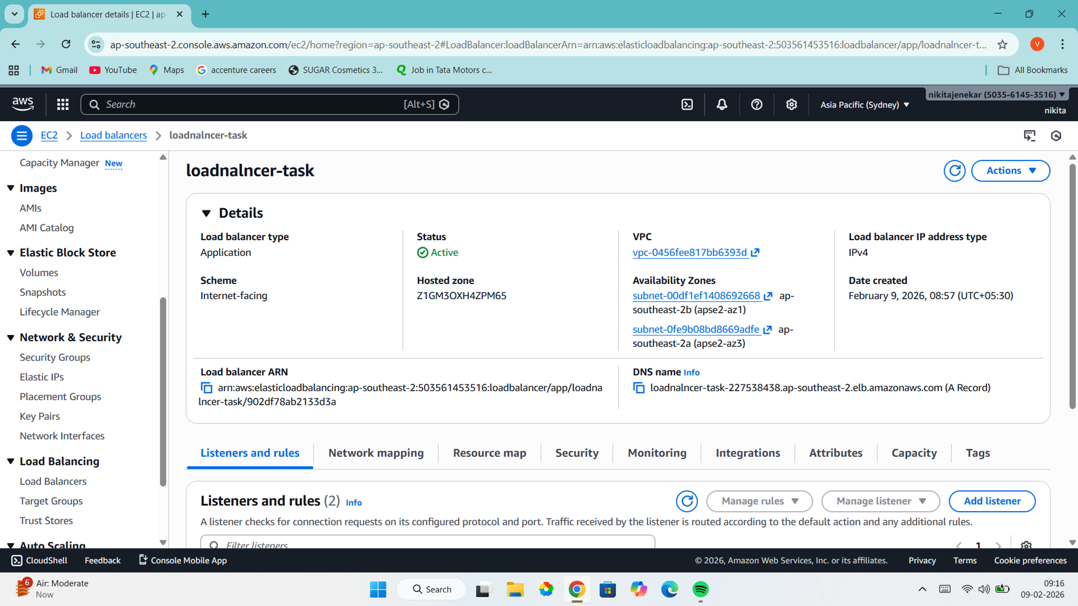
Load balancer URL

Slide 5
Step-by-step guide to perform task
I login to aws console with help of login credentials and went to VPC dashboard to create vpc, create VPC → Resources to create - Vpc only → give name – (Task-01) to identify easily. Set IPv4 CIDR – 10.0.0.0/16 → create vpc and vpc created.
Now create 2 public and 2 private subnet such that 1 public & 1 private in same availability zone and another 2 in different availability zone.
Create subnet → select Vpc Id (to Create subnets in this VPC that created) → give name as public-01 → select availability zone to where this subnet will reside (ap-southeast-2a) → IPv4 subnet CIDR block – 10.0.1.0/24 then go to create subnet ,subnet is created.
Follow the same procedure for creating subnet for,
Public-02—(ap-southeast-2b ) –(10.0.2.0/24)
Private-01—(ap-southeast-2a) –(10.0.3.0/24)
Private-02 –(ap-southeast-2a) –(10.0.4.0/24)

Slide 6
Now create internet gateway to enables communication between VPC and the internet. Create internet gateway → name for gateway – (gateway-task) → Create internet gateway. Now select the gateway and go to action and attach to the vpc for communication.
Create route table to determine where network traffic from your subnet or gateway is directed.
Go to create route table → give name (rt-public) → select the vpc to connect for this route table → create route table → select public1 subnet go to → Actions to edit subnet association → select subnet save association. And save it.
Now in route table → go routes → edit route → select destination (0.0.0.0/0) → target (internet gateway) → select gateway Id → save changes.
Do same for rt-private.

Slide 7
Now create security groups to act as a virtual firewall that controls the traffic for one or more instances.
SG Name | Inbound Rules | Purpose
loaderbalnce-sg | HTTP 80 from 0.0.0.0/0 | ALB (internet-facing)
ec2-sg | HTTP 80 from loaderbalnce-sg only | EC2 (ALB → EC2 only)

Slide 8
Launch EC2 Instances (Private Subnets)
Now launch instance Give name (Private-01) select AMI: Amazon Linux 2023
→ Instance type: t2.micro → Network: VPC as created (task-01) → Subnet: Private-01 →Auto-assign public IP: Disabled →Security group: ec2-sg
Now add user data script to host desired page
Below are the script,
#!/bin/bash
yum update -y
yum install -y nginx
# Start and enable nginx
systemctl start nginx
systemctl enable nginx
# Get instance metadata
INSTANCE_ID=$(curl -s http://169.254.169.254/latest/meta-data/instance-id)
AZ=$(curl -s http://169.254.169.254/latest/meta-data/placement/availability-zone)
# Create custom index.html
cat <<EOF > /usr/share/nginx/html/index.html
<!DOCTYPE html>
<html>
<head>
<title>Hello World</title>
</head>
<body style="text-align: center; font-family: Arial; margin-top: 100px;">
<h1>Hello World!</h1>
<p>Instance ID: <strong>$INSTANCE_ID</strong></p>
<p>Availability Zone: <strong>$AZ</strong></p>
<p>Served by: <strong>Nginx</strong></p>
</body>
</html>
EOF
# Restart nginx to apply changes
systemctl restart nginx
Now lunach instance tab and instance will be created with running status.
Now repeat for private instance with respective configuration.

Slide 9
Now create loadbalancer so give name as loadbalnce-task → select segurity groups for ALB (internet-facing) → add target groups for this we have to create target group and attach to loadbalncer. Then go to register ,select both instance and create target group.
It will take some time to active ate the status of loadbalncer after showing active copy the DNs of loadbalncer and hit in new tab to host
Finally it will show the desired web page
But in my case, I apologise that error has occurs showing 502 Bad Gateway , means nginx is not getting request from ALB and I will resolve it update soon.

Slide 10
List of AWS Resources Created
Resource Type | Count | Names/IDs Example
VPC | 1 | Task-01
Subnets | 4 | public-01 public-02 private-01 private-02
Internet Gateway | 1 | Gateway-task
Route Tables | 2 | public-rt, private-rt
Security Groups | 2 | loaderbalnce-sg ec2-sg
EC2 Instances | 2 | Private-01 Private-02
ALB | 1 | Loadnancer-task
Target Group | 1 | Tg-task

Slide 11
Security group configurations
SG Name | Inbound Rules | Purpose
Loadnancer-task | HTTP 80 from 0.0.0.0/0 | ALB (internet-facing)
ec2-sg | HTTP 80 from Loadnancer-task only | EC2 (ALB → EC2 only)

Slide 12
Configuration Files
Nginx Configuration Files
#!/bin/bash
yum update -y
yum install -y nginx
# Start and enable nginx
systemctl start nginx
systemctl enable nginx

Slide 13
HTML page code
# Get instance metadata
INSTANCE_ID=$(curl -s http://169.254.169.254/latest/meta-data/instance-id)
AZ=$(curl -s http://169.254.169.254/latest/meta-data/placement/availability-zone)
# Create custom index.html
cat <<EOF > /usr/share/nginx/html/index.html
<!DOCTYPE html>
<html>
<head>
<title>Hello World</title>
</head>
<body style="text-align: center; font-family: Arial; margin-top: 100px;">
<h1>Hello World!</h1>
<p>Instance ID: <strong>$INSTANCE_ID</strong></p>
<p>Availability Zone: <strong>$AZ</strong></p>
<p>Served by: <strong>Nginx</strong></p>
</body>
</html>
EOF
# Restart nginx to apply changes
systemctl restart nginx

Slide 14
Thank You

